Slide 1
JSALT
Kenneth Church
May 9, 2023
https://github.com/kwchurch/JSALT_Better_Together

Slide 2
Readings: Before May 14 https://github.com/kwchurch/JSALT_Better_Together/tree/main/examples/near/reading_list
https://huggingface.co/allenai/specter
https://github.com/allenai/scirepeval
https://www.ijcai.org/proceedings/2019/0594.pdf (Prone Paper)
https://arxiv.org/pdf/2103.09430.pdf (OGB-LSC Paper; KDD Cup)
https://arxiv.org/pdf/1709.07604.pdf (Survey)

Slide 3
Purpose of Today’s Meeting
Teamwork: Meet ‘n Greet
Action Item: Scope Project
What are we going to do?
Before France
During France
After France
Get up to speed: Tutorials, Reading Groups, etc.

Slide 4

Citation Graph: Clearly useful for some tasks
Recommendation Systems
What should I read?
What should I cite?
Assign submissions to reviewers
Find similar papers
Rank retrieval
Consider reviewer matching
When we started EMNLP
I would often assign submissions to tracks by hand (@ 2 min/paper)
I would skim title and abstract
and then flip to the references
Abstracts are hard to read
Formal language, long sentences
Often easier to match on refs
If a reviewer is cited, then they
know the background,
and agree with the approach
Often, Citations >> Abstracts
Poor matching → Iffy Reviewing → SOTA-Chasing

Slide 5
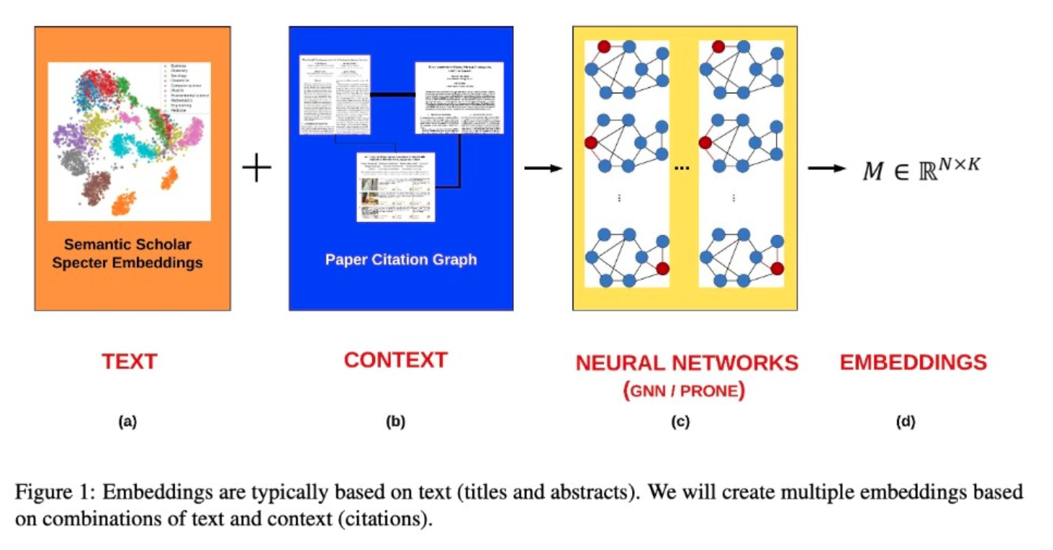

Slide 6
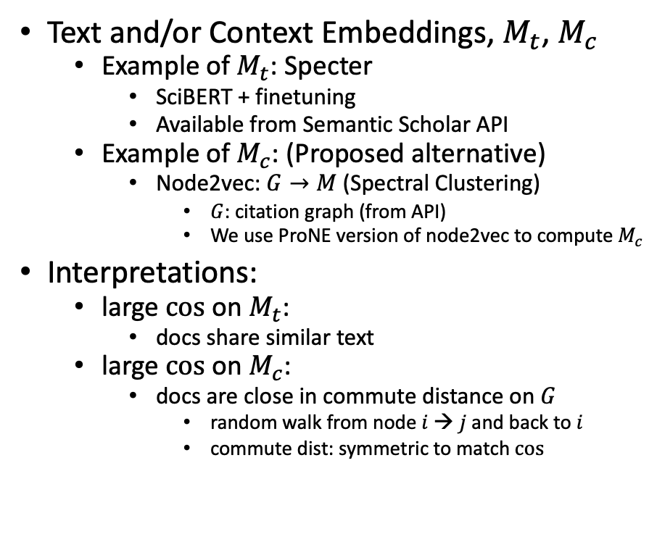
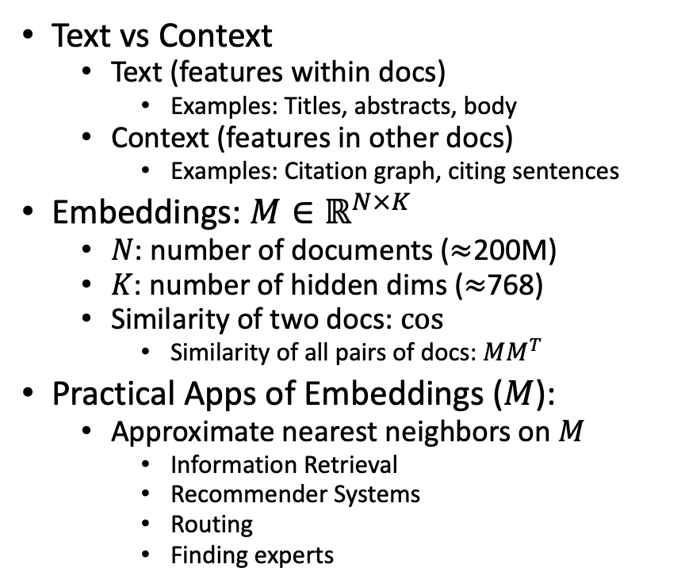
Proposal: Build Multiple Embeddings to Capture Text and/or Context
Text vs Context
Text (features within docs)
Examples: Titles, abstracts, body
Context (features in other docs)
Examples: Citation graph, citing sentences
Embeddings: $M∈ℝ^{N×K}$
$N$: number of documents ($≈$200M)
$K$: number of hidden dims ($≈$768)
Similarity of two docs: $cos⁡$
Similarity of all pairs of docs: $MM^{T}$
Practical Apps of Embeddings ($M$):
Approximate nearest neighbors on $M$
Information Retrieval
Recommender Systems
Routing
Finding experts
Text and/or Context Embeddings, $M_{t}$, $M_{c}$
Example of $M_{t}$: Specter
SciBERT + finetuning
Available from Semantic Scholar API
Example of $M_{c}$: (Proposed alternative)
Node2vec: $G→M$ (Spectral Clustering)
$G$: citation graph (from API)
We use ProNE version of node2vec to compute $M_{c}$
Interpretations:
large $cos$ on $M_{t}$:
docs share similar text
large $cos$ on $M_{c}$:
docs are close in commute distance on $G$
random walk from node $i$→ $j$ and back to $i$
commute dist: symmetric to match $cos$
old
Latent Semantic Indexing
new
Currently, not in Semantic Scholar

Slide 7
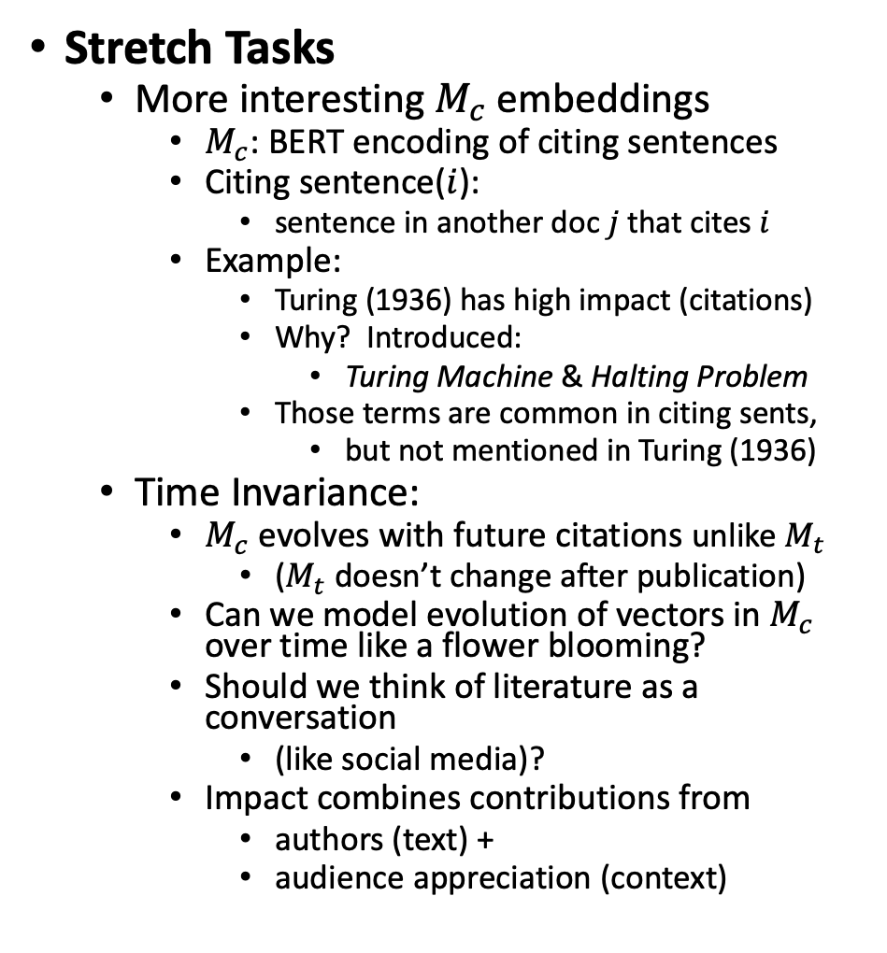
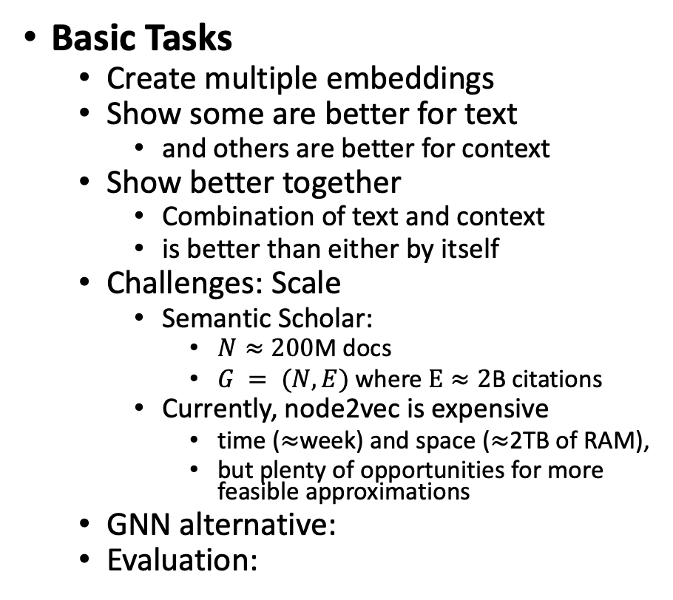
Basic & Stretch Tasks
Stretch Tasks
More interesting $M_{c}$embeddings
$M_{c}$: BERT encoding of citing sentences
Citing sentence($i$):
sentence in another doc $j$that cites $i$
Example:
Turing (1936) has high impact (citations)
Why? Introduced:
Turing Machine & Halting Problem
Those terms are common in citing sents,
but not mentioned in Turing (1936)
Time Invariance:
$M_{c}$ evolves with future citations unlike $M_{t}$
($M_{t}$doesn’t change after publication)
Can we model evolution of vectors in $M_{c}$ over time like a flower blooming?
Should we think of literature as a conversation
(like social media)?
Impact combines contributions from
authors (text) +
audience appreciation (context)
Basic Tasks
Create multiple embeddings
Show some are better for text
and others are better for context
Show better together
Combination of text and context
is better than either by itself
Challenges: Scale
Semantic Scholar:
$N≈200$M docs
$G = (N, E)$where $E≈2$B citations
Currently, node2vec is expensive
time ($≈$week) and space ($≈$2TB of RAM),
but plenty of opportunities for more feasible approximations
GNN alternative:
Evaluation:
Anchor Text
Current status
(K=280)

Slide 8
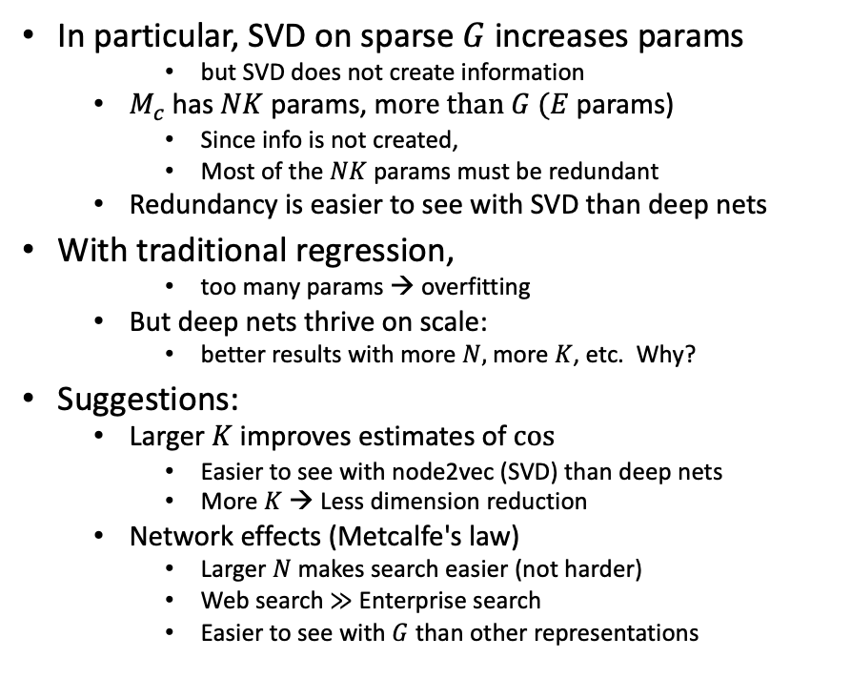
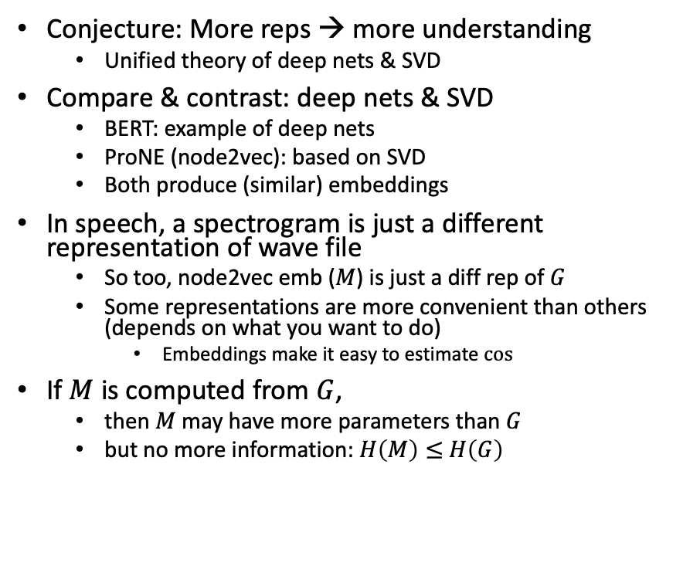
Bigger Stretch: Theoretical combinations of deep nets & SVD
Conjecture: More reps → more understanding
Unified theory of deep nets & SVD
Compare & contrast: deep nets & SVD
BERT: example of deep nets
ProNE (node2vec): based on SVD
Both produce (similar) embeddings
In speech, a spectrogram is just a different representation of wave file
So too, node2vec emb ($M$) is just a diff rep of $G$
Some representations are more convenient than others (depends on what you want to do)
Embeddings make it easy to estimate $cos⁡⁡$
If $M$ is computed from $G$,
then $M$ may have more parameters than $G$
but no more information: $H\left(M\right)≤$ $H\left(G\right)$
In particular, SVD on sparse $G$increases params
but SVD does not create information
$M_{c}$has $NK$ params, m$ore than G$ $(E$params)
Since info is not created,
Most of the $NK$ params must be redundant
Redundancy is easier to see with SVD than deep nets
With traditional regression,
too many params → overfitting
But deep nets thrive on scale:
better results with more $N,$ more $K$, etc. Why?
Suggestions:
Larger $K$ improves estimates of $cos⁡$
Easier to see with node2vec (SVD) than deep nets
More $K$ → Less dimension reduction
Network effects (Metcalfe's law)
Larger $N$ makes search easier (not harder)
Web search $≫$ Enterprise search
Easier to see with $G$ than other representations

Slide 9
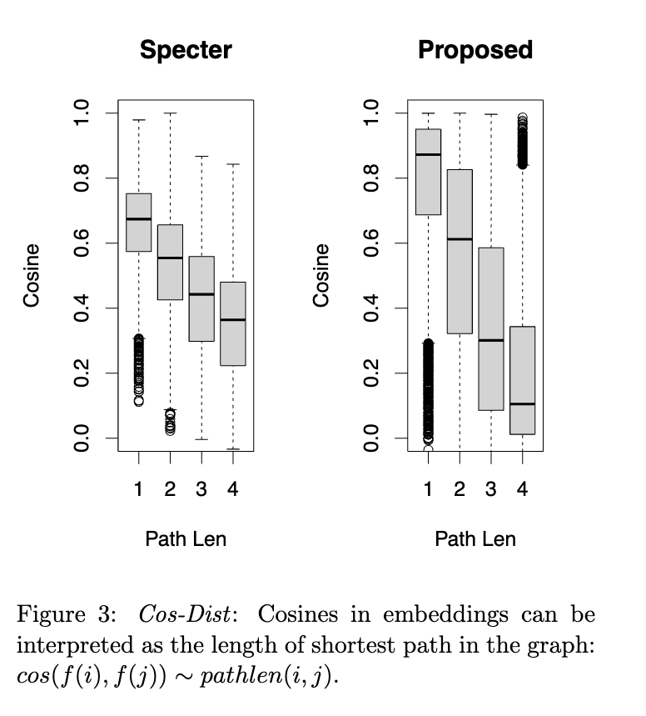
Multiple Representations
Speech:
Time Domain
Frequency Domain
Documents:
Citation Graphs
Embeddings
Operations
Filtering (speech):
Time: convolution
Freq: multiplication
Similarity (documents)
Graphs:
Random Walks
Embeddings:
Cosines
ANN (approximate nearest neighbors)

Slide 10

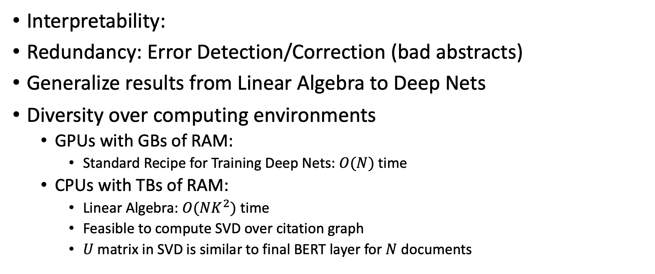
Advantages of Multiple Representations
Interpretability:
Redundancy: Error Detection/Correction (bad abstracts)
Generalize results from Linear Algebra to Deep Nets
Diversity over computing environments
GPUs with GBs of RAM:
Standard Recipe for Training Deep Nets: $O(N)$ time
CPUs with TBs of RAM:
Linear Algebra: $O(NK^{2})$ time
Feasible to compute SVD over citation graph
$U$matrix in SVD is similar to final BERT layer for $N$ documents

Slide 11
Outline
Data
Use Cases
What’s Where (GitHub; Globus)
Tutorial Background

Slide 12
Data

Slide 13
Challenges
Missing/Corrupted Values
Literature: Big & Growing Quickly
Time:
Papers don’t change after publication,
But citations do
Specter embeddings don’t change after publication
But ProNE embeddings do
Systems: velocity, volume, value, variety and veracity
Scale (Volume)
Change (Velocity)

Slide 14
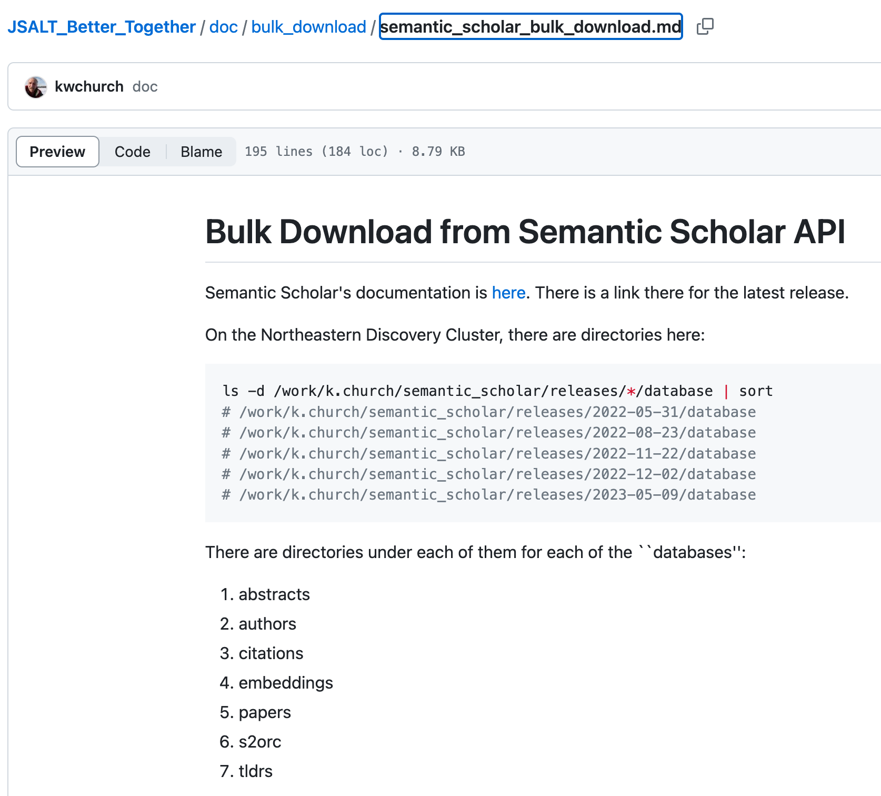
Bulk Downloads from …
See https://github.com/kwchurch/JSALT_Better_Together/tree/main/doc/bulk_download
for documentation on
what is available for bulk download
where to find what on Northeastern Discovery Cluster
and if you don’t have access to that
how to get this stuff from
Semantic Scholar
OpenAlex

Slide 15
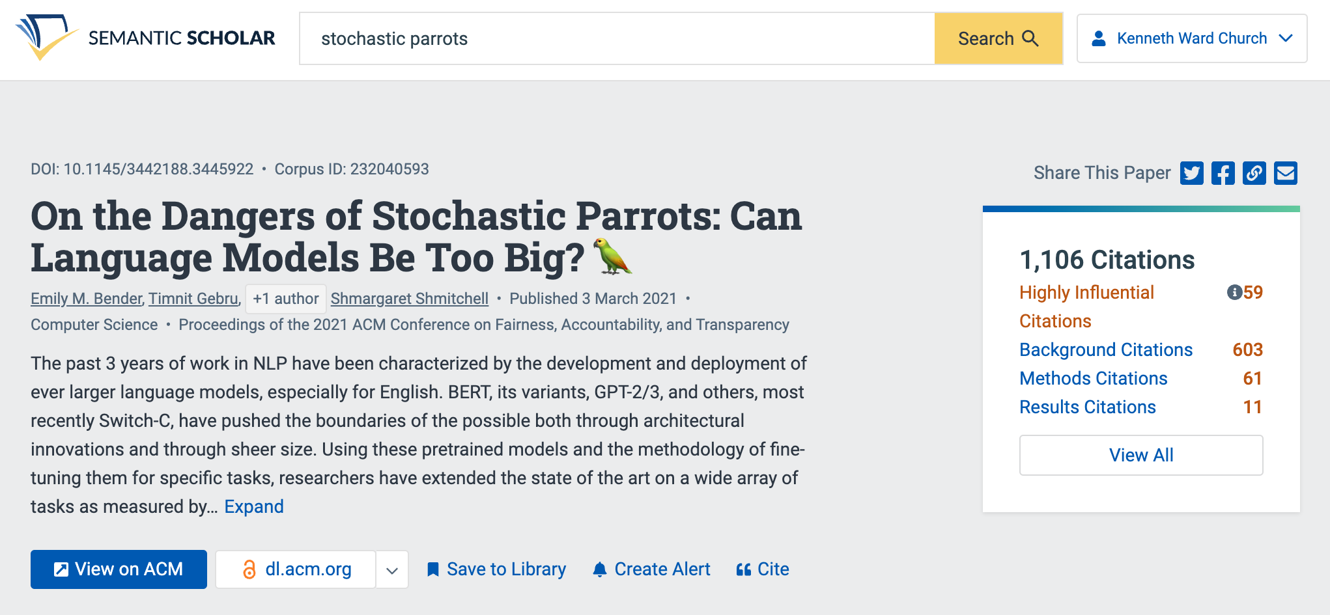

Example of Semantic Scholar Page https://www.semanticscholar.org/paper/On-the-Dangers-of-Stochastic-Parrots%3A-Can-Language-Bender-Gebru/6d9727f1f058614cada3fe296eeebd8ec4fc512a https://github.com/kwchurch/JSALT_Better_Together/blob/main/src/fetch_from_semantic_scholar_api.py https://www.semanticscholar.org/product/api

Slide 16
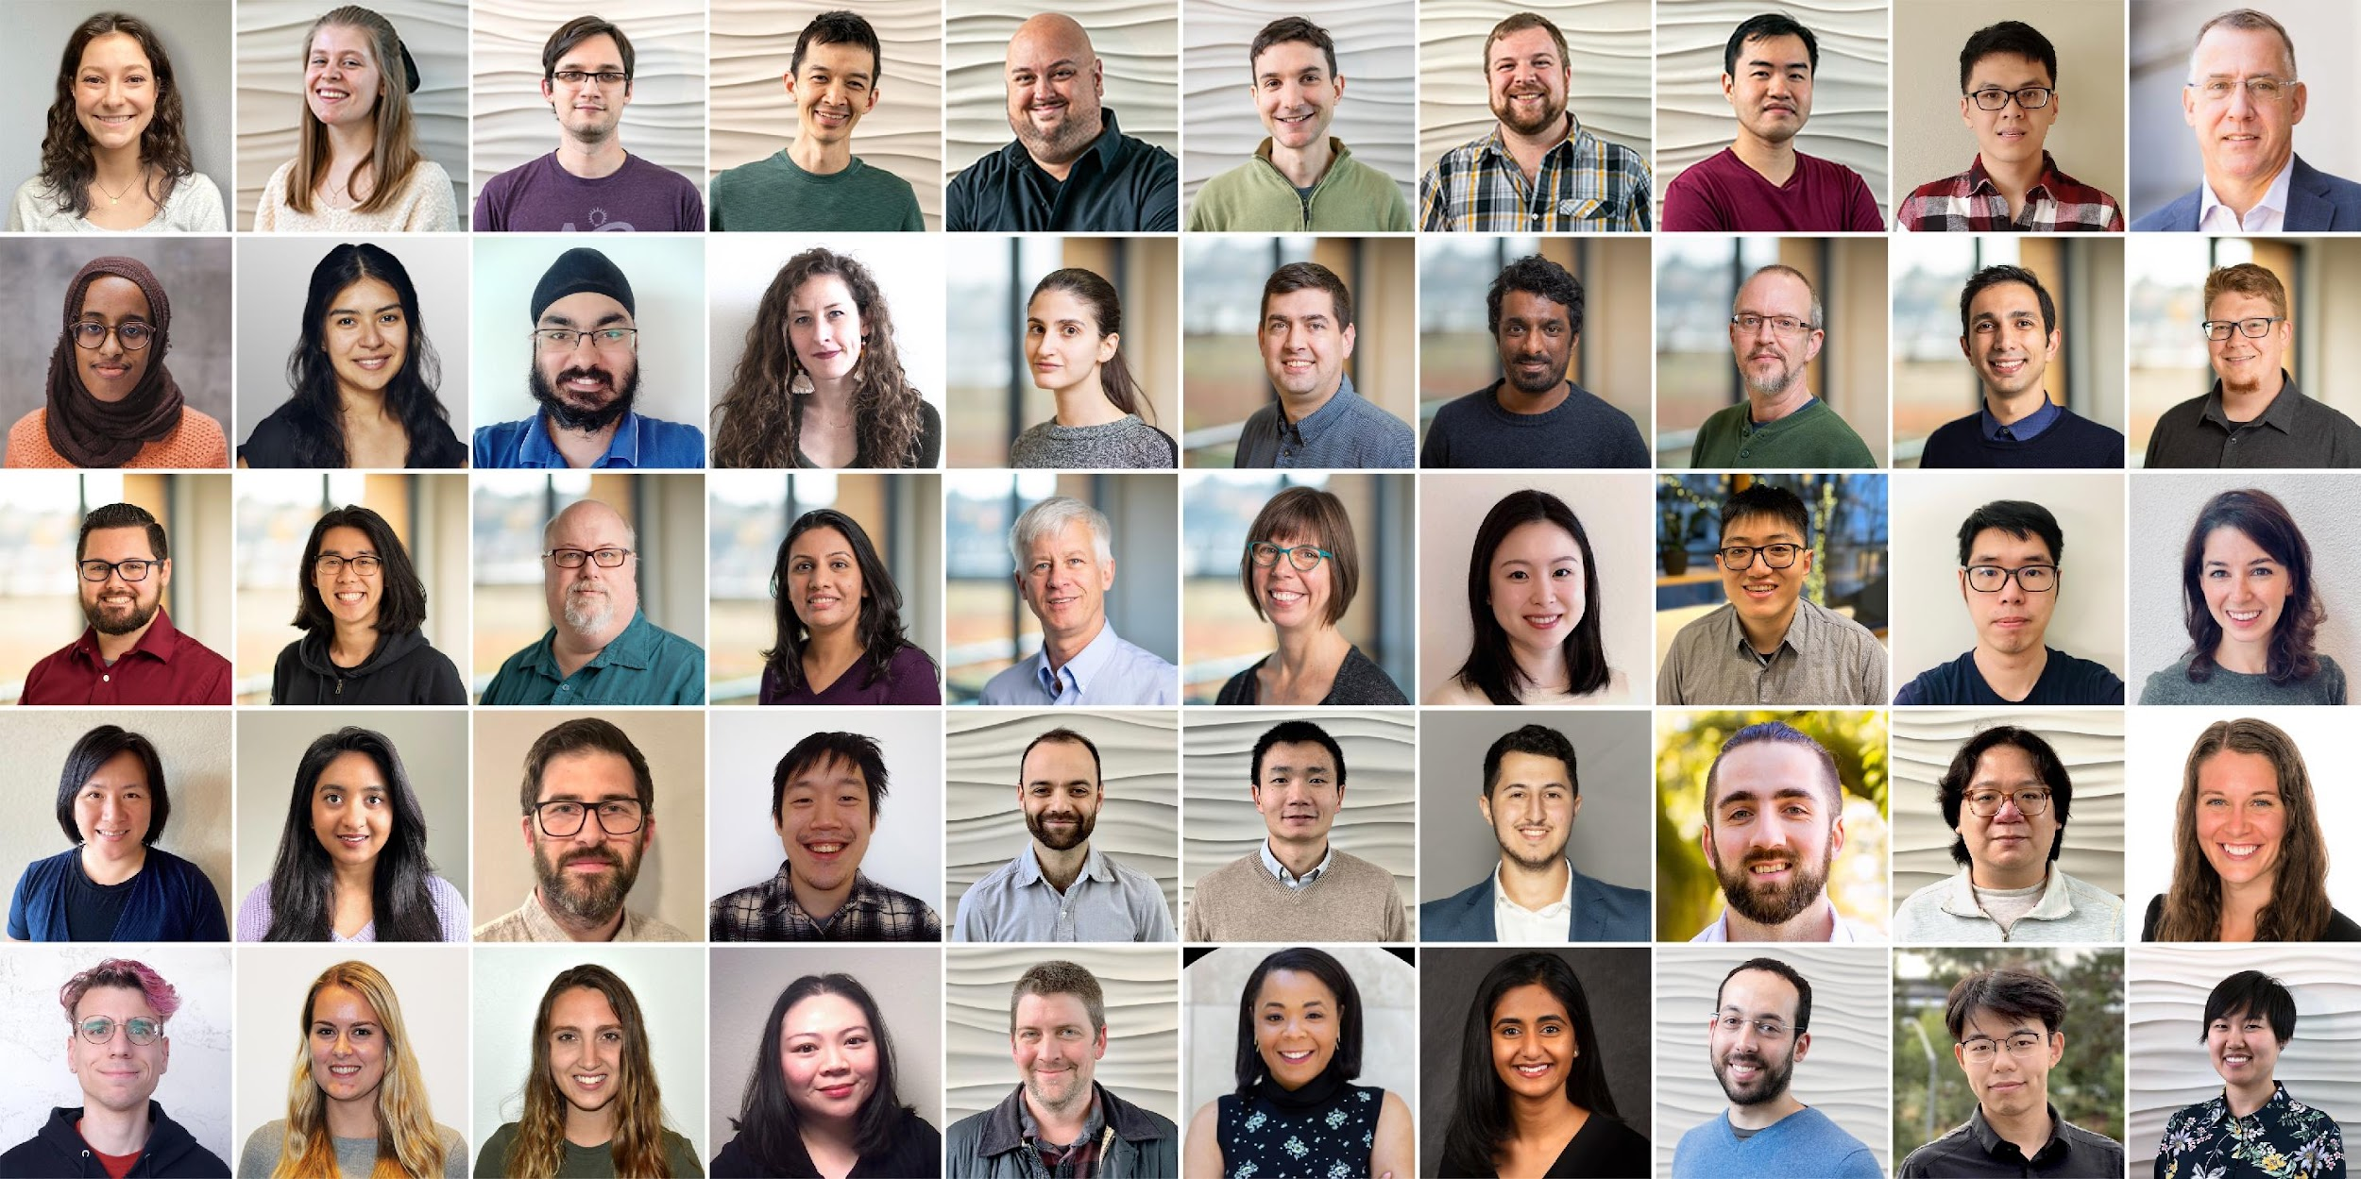
Semantic Scholar: Significant Effort (slide from Dan Weld)
50 person team
7 year project
207M+ scientific paper index
8M+ monthly active users

Slide 17
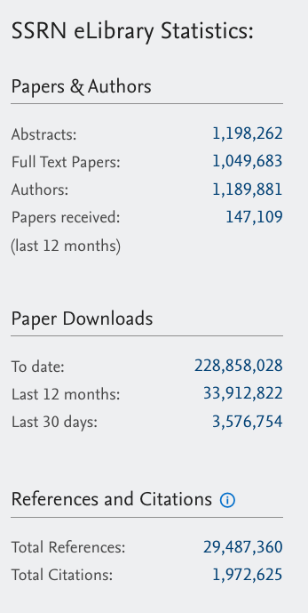
Diversity of Fields of Study Weak on Law, Journalism, etc.
Papers (millions) | Field of Study | Papers (millions) | Field of Study
45.2 | Medicine | 3.7 | Business
12.9 | Chemistry | 3.4 | Sociology
12.9 | Computer_Science | 3.0 | Geography
12.7 | Biology | 2.7 | Economics
10.0 | Materials_Science | 2.7 | Environmental_Science
8.2 | Engineering | 2.6 | Geology
6.8 | Physics | 2.1 | History
6.7 | Psychology | 1.8 | Art
5.3 | Mathematics | 1.1 | Philosophy
4.0 | Political_Science

Slide 18
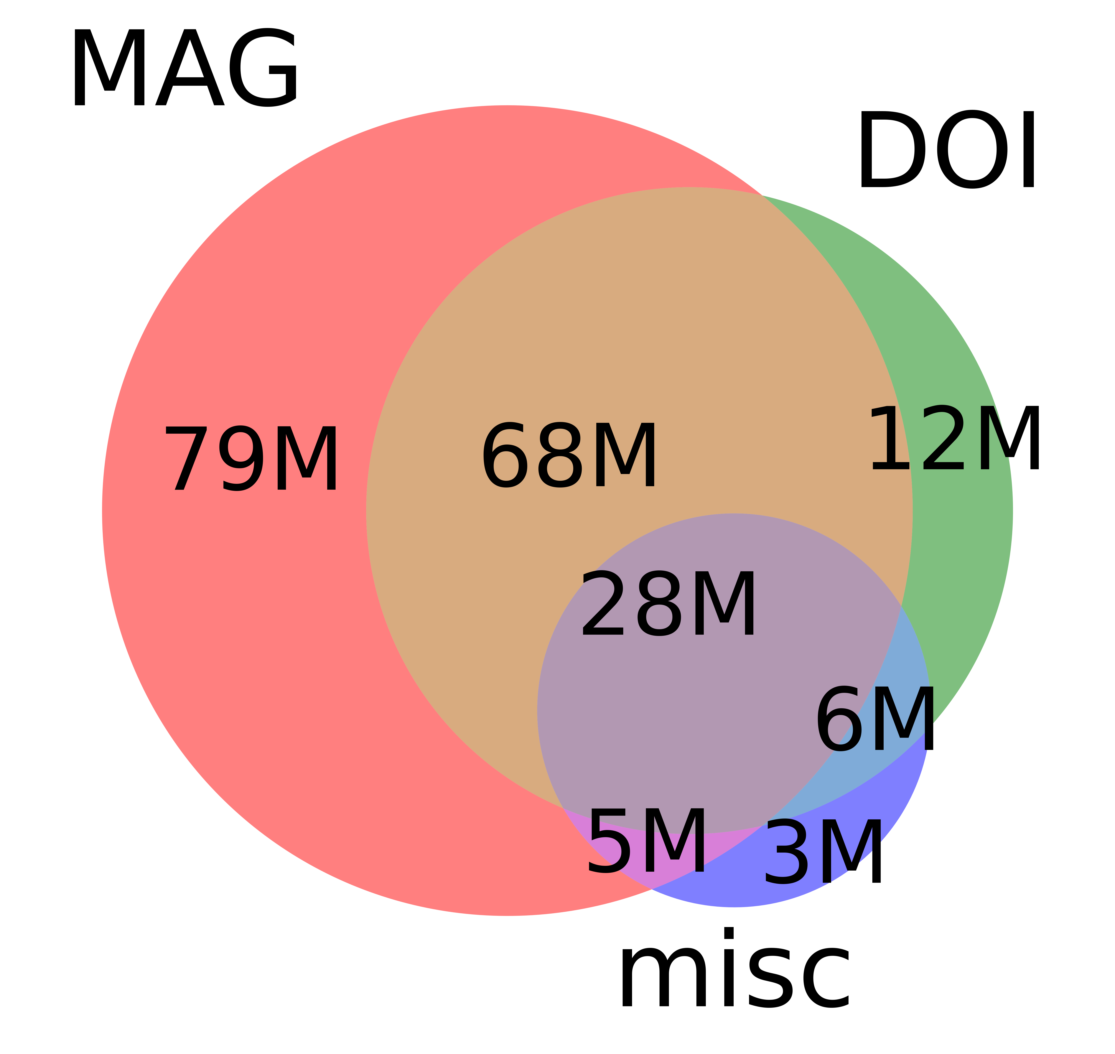
Scale: Smaller than Web (but challenging for academia)
 | Source | Papers (millions)
1 | CorpusId | 207.80
2 | MAG (Microsoft Academic Graph) | 182.18
3 | DOI | 113.54
4 | PubMed | 35.03
5 | DBLP | 6.06
6 | PubMedCentral | 4.86
7 | ArXiv | 2.15
8 | ACL | 0.08
 | totals | 551.71

Slide 19
Challenges
Scale & Growth
Missing Values
Corrupted Values

Slide 20
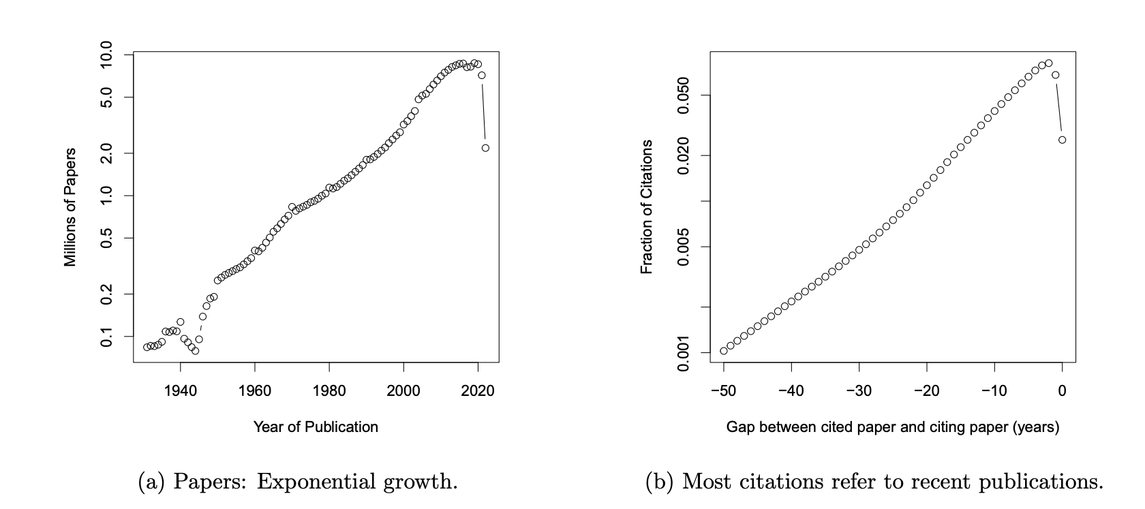
Scale Challenge: Big & Growing (Quickly)

Slide 21
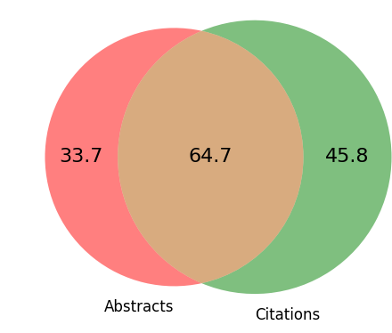
Missing Values: Many paper ids have abstracts or citations (but not both)
There are more papers
with citations (but not abstracts) [45.8M]
than vice versa [33.7M]
Example: highly cited book
Books do not have abstracts
(Most books are behind paywalls)
Better together opportunity
Text + Context (Citations)
Take advantage of what we have
Robust to missing values
Millions of Papers in Semantic Scholar
Millions of Papers in Semantic Scholar
Millions of Papers in Semantic Scholar
23%
45%
32%
Mentioned in Citation Graph
+63.6M Papers with neither

Slide 22
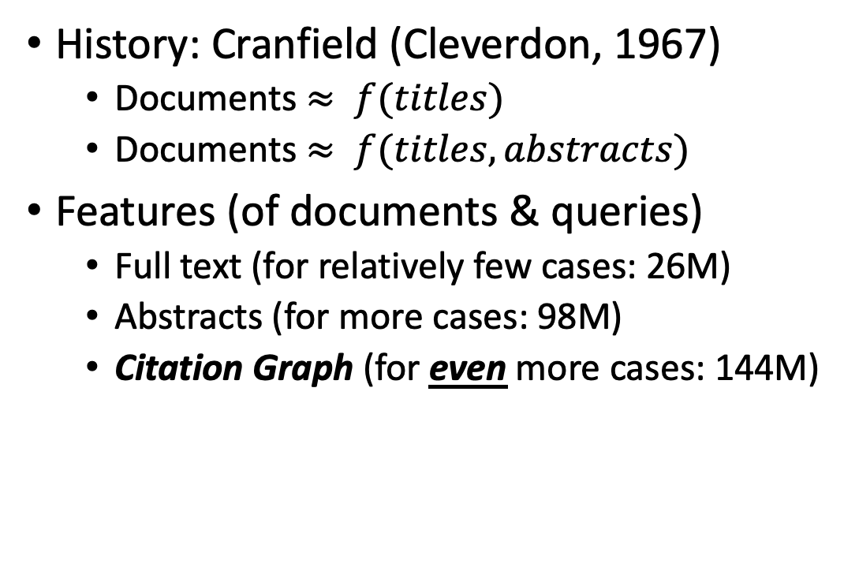
Much of the Literature on Academic Search is Based on Titles and Abstracts (and little else)
History: Cranfield (Cleverdon, 1967)
Documents $≈ f(titles)$
Documents $≈ f(titles, abstracts)$
Features (of documents & queries)
Full text (for relatively few cases: 26M)
Abstracts (for more cases: 98M)
Citation Graph (for even more cases: 144M)
N (millions of paper ids) | Case
207.8 | In Semantic Scholar
144.0 | With abstracts, citations and/or references
110.5 | With citations and/or references
98.4 | With abstracts
25.9 | With full text

Slide 23


Rank | Specter | Proposed | Paper
query | 1.000 | 1.000 | 1097: On stress and linguistic rhythm
1 | 0.908 | 0.926 | 0: Linguistic Society of America Structure and Intonation
2 | 0.895 | 0.977 | 475: Preliminaries to linguistic phonetics
3 | 0.885 | 0.921 | 25: Linguistic Society of America On the Definition of Word by
4 | 0.881 | 0.763 | 37: On some defferences between Chinese and Japanese '-Wh'-elements
5 | 0.880 | 0.946 | 2: Some accentuation properties in Japanese and lexical phonology
6 | 0.865 | 0.824 | 6: Two Types of Zi-Verbs in Japanese
7 | 0.777 | 0.097 | 15: The Value of Natural Sounds
8 | 0.766 | 0.089 | 16: Re-Examining the Foundations
9 | 0.757 | 0.106 | 8: Facts and Faith in Biblical History
1 | 0.578 | 0.998 | 226: The phonology of rhythm in English
2 | 0.530 | 0.997 | 74: A grid-based theory of English meter
3 | -1.000 | 0.996 | 5: "What does Phonology tell us about Stress and Rhythm? Some Reflections on the Phonology of Stress"
4 | 0.460 | 0.994 | 1: Syllable structure and stress in Bahdinani Kurdish
5 | 0.442 | 0.994 | 35: Schwa in phonological theory
6 | -1.000 | 0.994 | 163: The Sound Pattern of Russian: A Linguistic and Acoustical Investigation
7 | 0.542 | 0.993 | 27: Empirical evidence for a deletion formulation of the rhythm rule in English
8 | 0.552 | 0.993 | 95: Prosodic Structure Above the Word
9 | 0.334 | 0.993 | 0: Syllable Contraction in Cantonese A-not-A Constructions: An Optimality Account

Slide 24
Summary of Data Discussion
Bulk Downloads
Schema
papers: externalIds, titles, authors, citations, references…
authors: names, externalIds, papercount, hindex, citationcount…
embeddings: vector
abstracts: externalIds, abstract…
tldr (too long; didn’t read): text
Size & Growth
Quality:
Missing Values
Corrupted Values

Slide 25
Use Cases

Slide 26
Outline
Data
Use Cases
What’s Where (GitHub; Globus)
Tutorial Background

Slide 27
Use Cases
Recommender Systems: what should I read? Cite?
Input: query (text and/or documents)
Output: documents
Opportunity: many systems focus too much on relevance
Don’t want papers that are buzz word compliant, but not credible
Most papers aren’t cited (and aren’t worth reading or citing)
Routing submissions to reviewers
Features: text, abstracts, links, etc.
Opportunity: many systems (openreview, softconf, CMT, etc.)
Few successes: iffy software is worse than what we used to do by hand
Bad for society
Summarization
Most summarization systems process each document, one by one
Can we compare and contrast a pair of documents?
What if we had a large collection of documents?
Cluster collection (with kmeans)
Compare within and across clusters

Slide 28
Recommendation Tasks
Input query: a document
Output: similar documents
Examples:
https://github.com/kwchurch/JSALT_Better_Together/blob/main/examples/similar_documents/reading_list/DeepWalk.md
https://github.com/kwchurch/JSALT_Better_Together/blob/main/examples/similar_documents/authors/details/Emily-M.-Bender/both/232040593.md
Suppose you want to create some tables like above:
https://github.com/kwchurch/JSALT_Better_Together/blob/main/doc/find_similar_docs.md
Warning: requires access to large files, C code, etc.

Slide 29
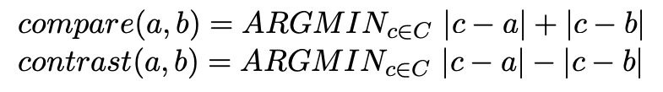
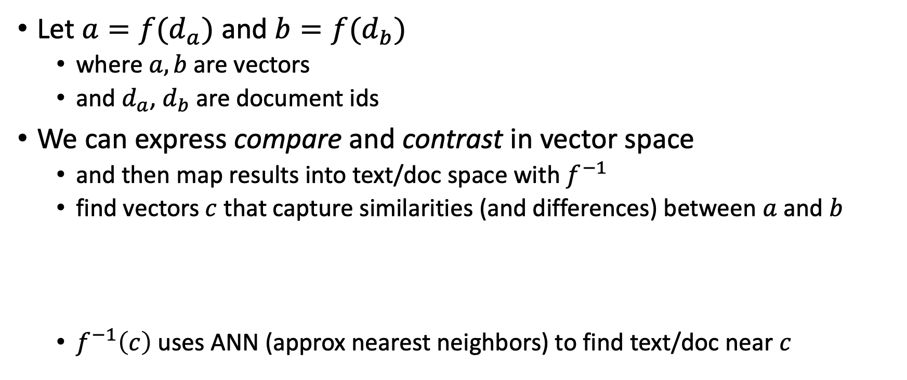
Summarization: Compare & Contrast
Let $a=f(d_{a})$ and $b=f(d_{b})$
where $a, b$are vectors
and $d_{a}$, $d_{b}$are document ids
We can express compare and contrast in vector space
and then map results into text/doc space with $f^{−1}$
find vectors $c$ that capture similarities (and differences) between $a$ and $b$
$f^{−1}\left(c\right)$ uses ANN (approx nearest neighbors) to find text/doc near $c$

Slide 30
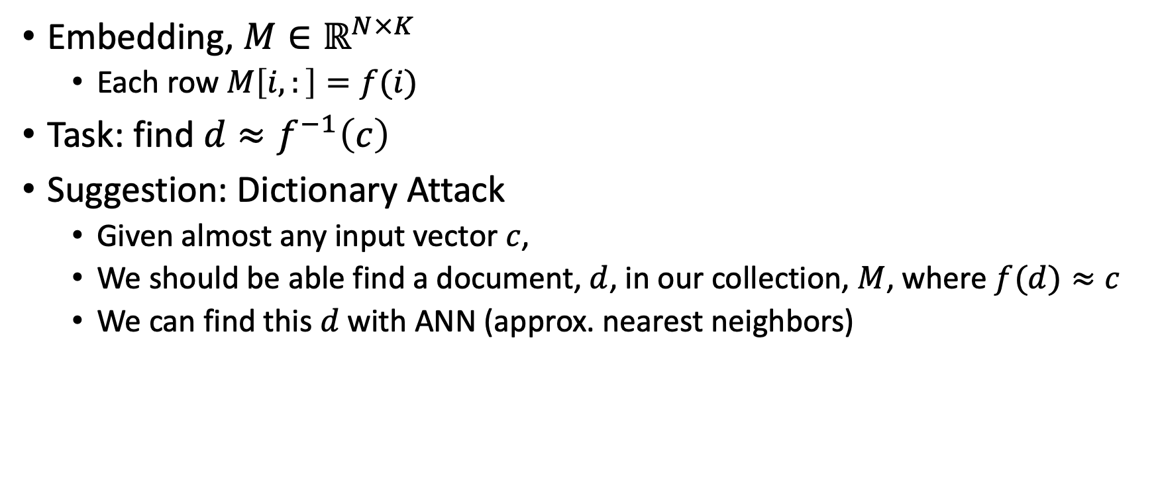
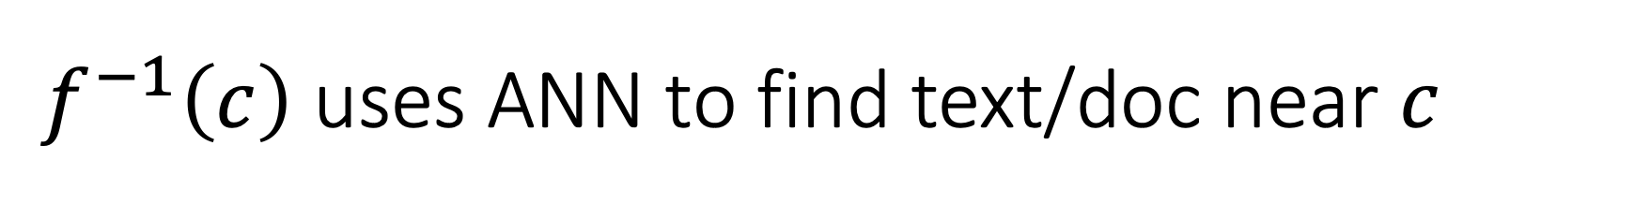
$f^{−1}\left(c\right)$ uses ANN to find text/doc near $c$
Embedding, $M∈ℝ^{N×K}$
Each row $M\left[i,:\right]=f(i)$
Task: find $d≈f^{−1}\left(c\right)$
Suggestion: Dictionary Attack
Given almost any input vector $c$,
We should be able find a document, $d$, in our collection, $M$, where $f(d)≈c$
We can find this $d$ with ANN (approx. nearest neighbors)

Slide 31
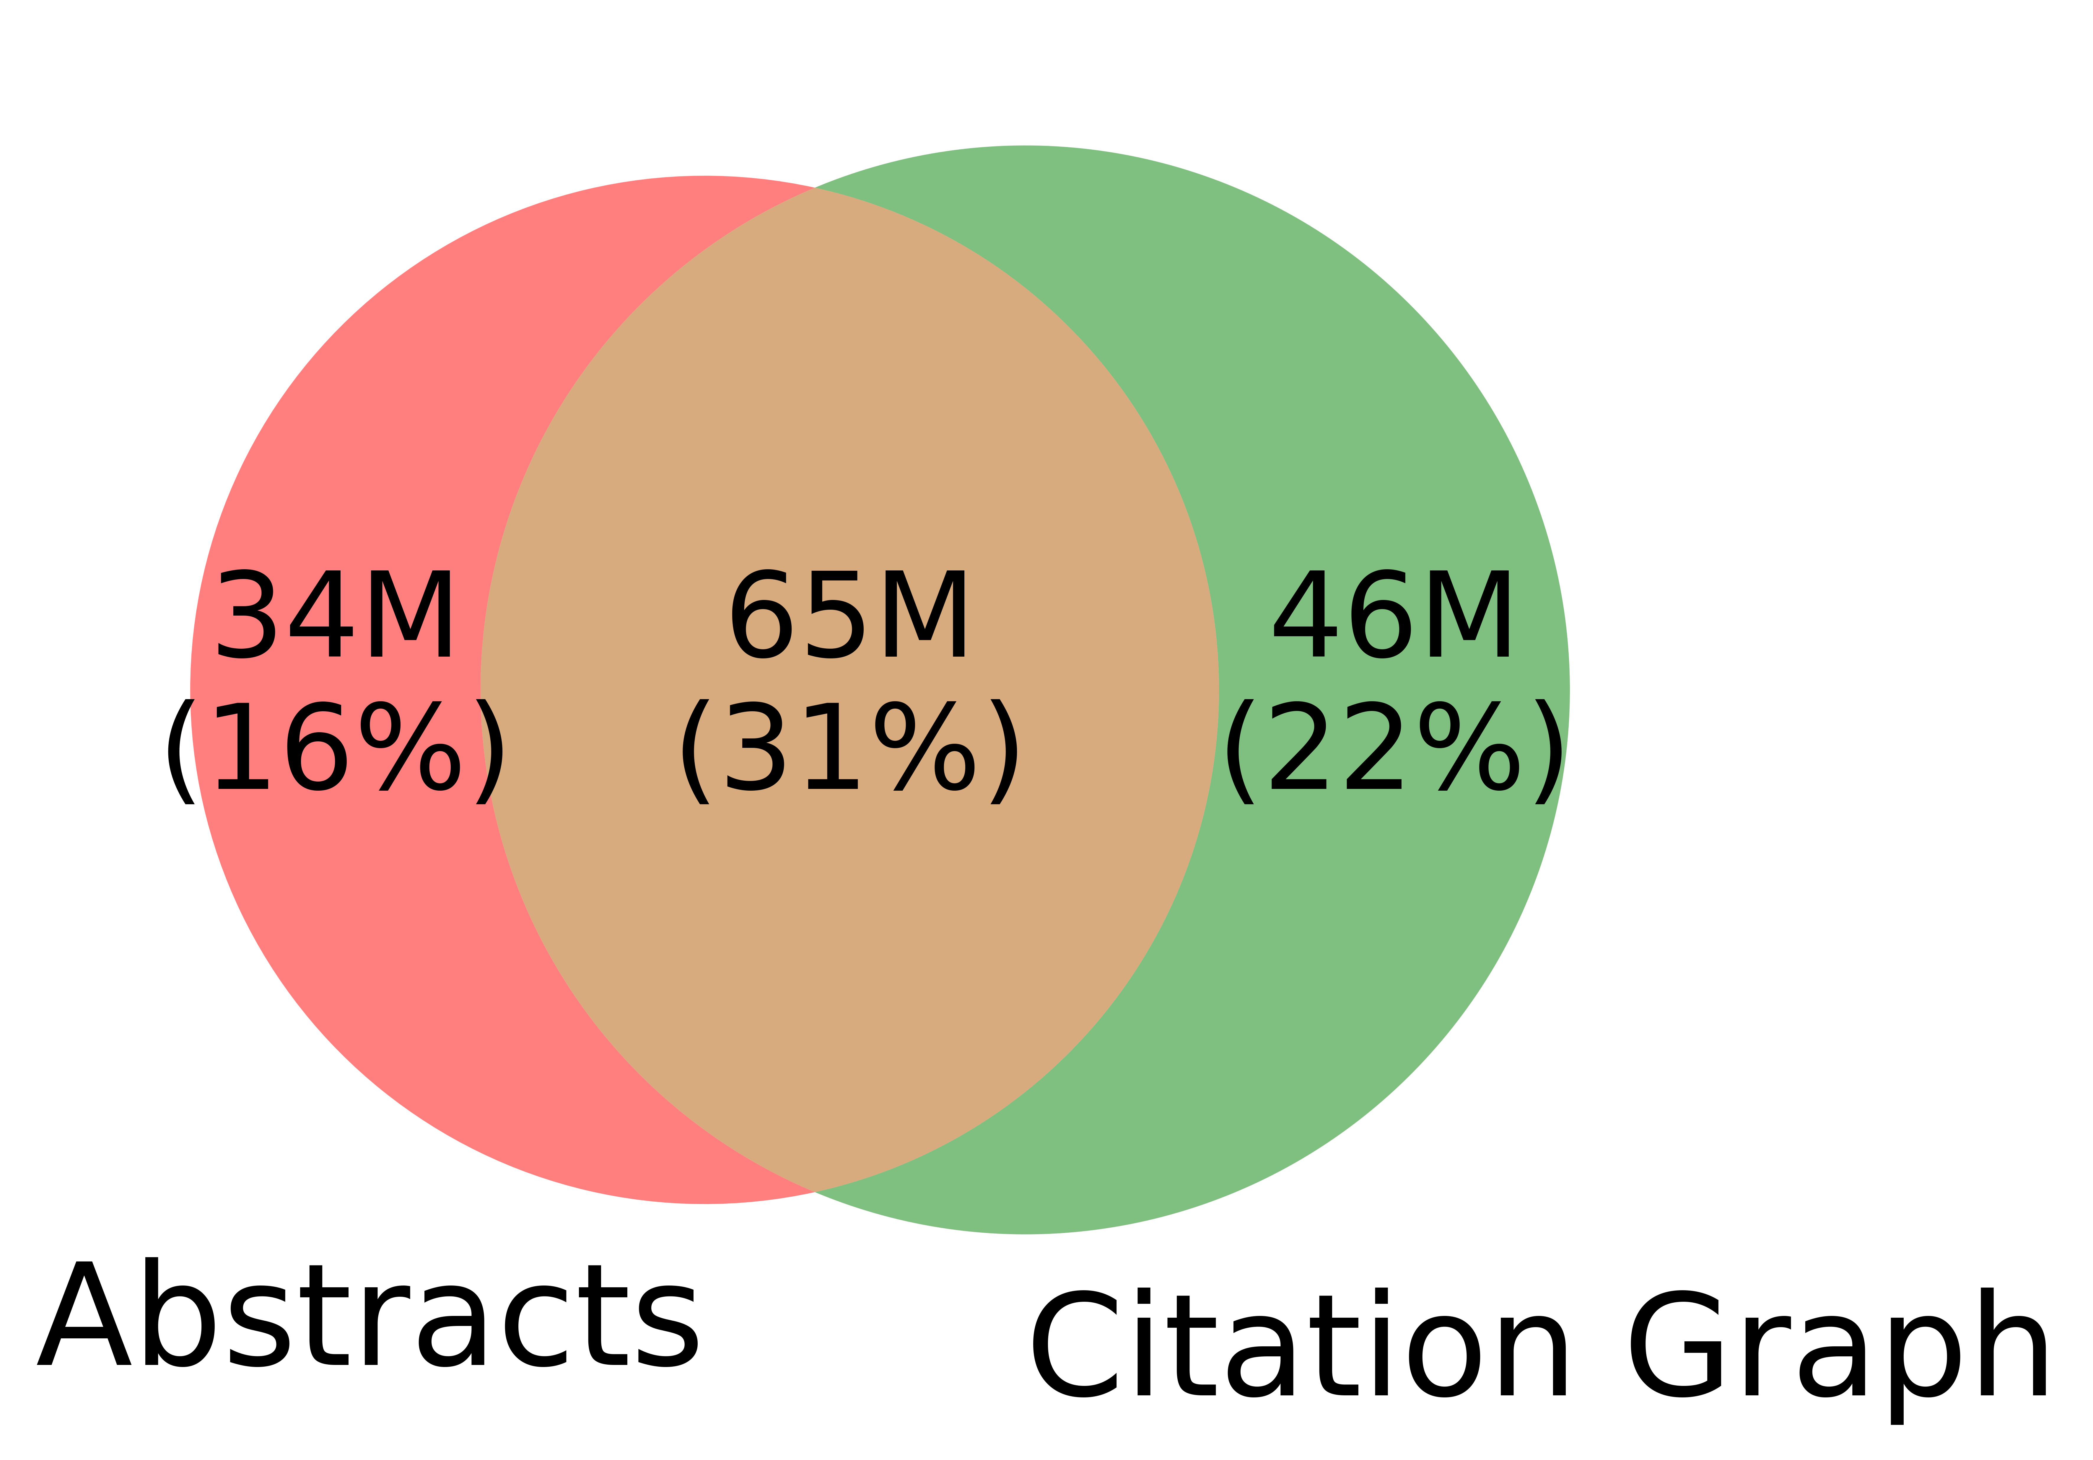
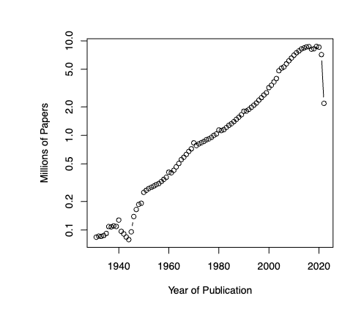
Some Projects
Resources:
More embeddings on Globus
ProNE, Citing Sentences
More models on HuggingFace
Code posted on GitHub
Bibliometrics
Applications of Embeddings
Inputs: text and/or links
Rank Retrieval / Recommendation
Assigning papers to reviewers
Summarization
Compare & Contrast Docs/Clusters
Evaluation:
Benchmarks: pros & cons
Evaluate text and/or link inputs
Systems
Support incremental updates
Support larger graphs
Establish better together
text + links >> either by itself
Computing evironments
GPUs with GBs of RAM
CPUs with TBs of RAM
Unified Theory:
Deep Nets
Linear Algebra

Slide 32
Bibliometrics
Growth over time
Predict citations for a paper as a function of time
Predict h-index for an author as a function of time
Predict embeddings as a function of time
Citations and inflation?
Do authors these days have more citations than a decade ago?
Too much of a good thing???
Find authors that publish too much
Why? Cheating? Iffy data?
Find abstracts that are too similar
Why? Dups? JSTOR bug? Confusions between authors and editors?

Slide 33
Sound Bites / Differentiators / Themes
Inputs & Outputs: Text + Links
Too many systems focus on text
Links: big deal for web search
Multiple Representations
Missing/Corrupted Values
Error Detection/Correction
Scale: Blessing & Curse
Blessing: Metcalfe’s Law
Curse: Growth (need incremental updates)

Slide 34
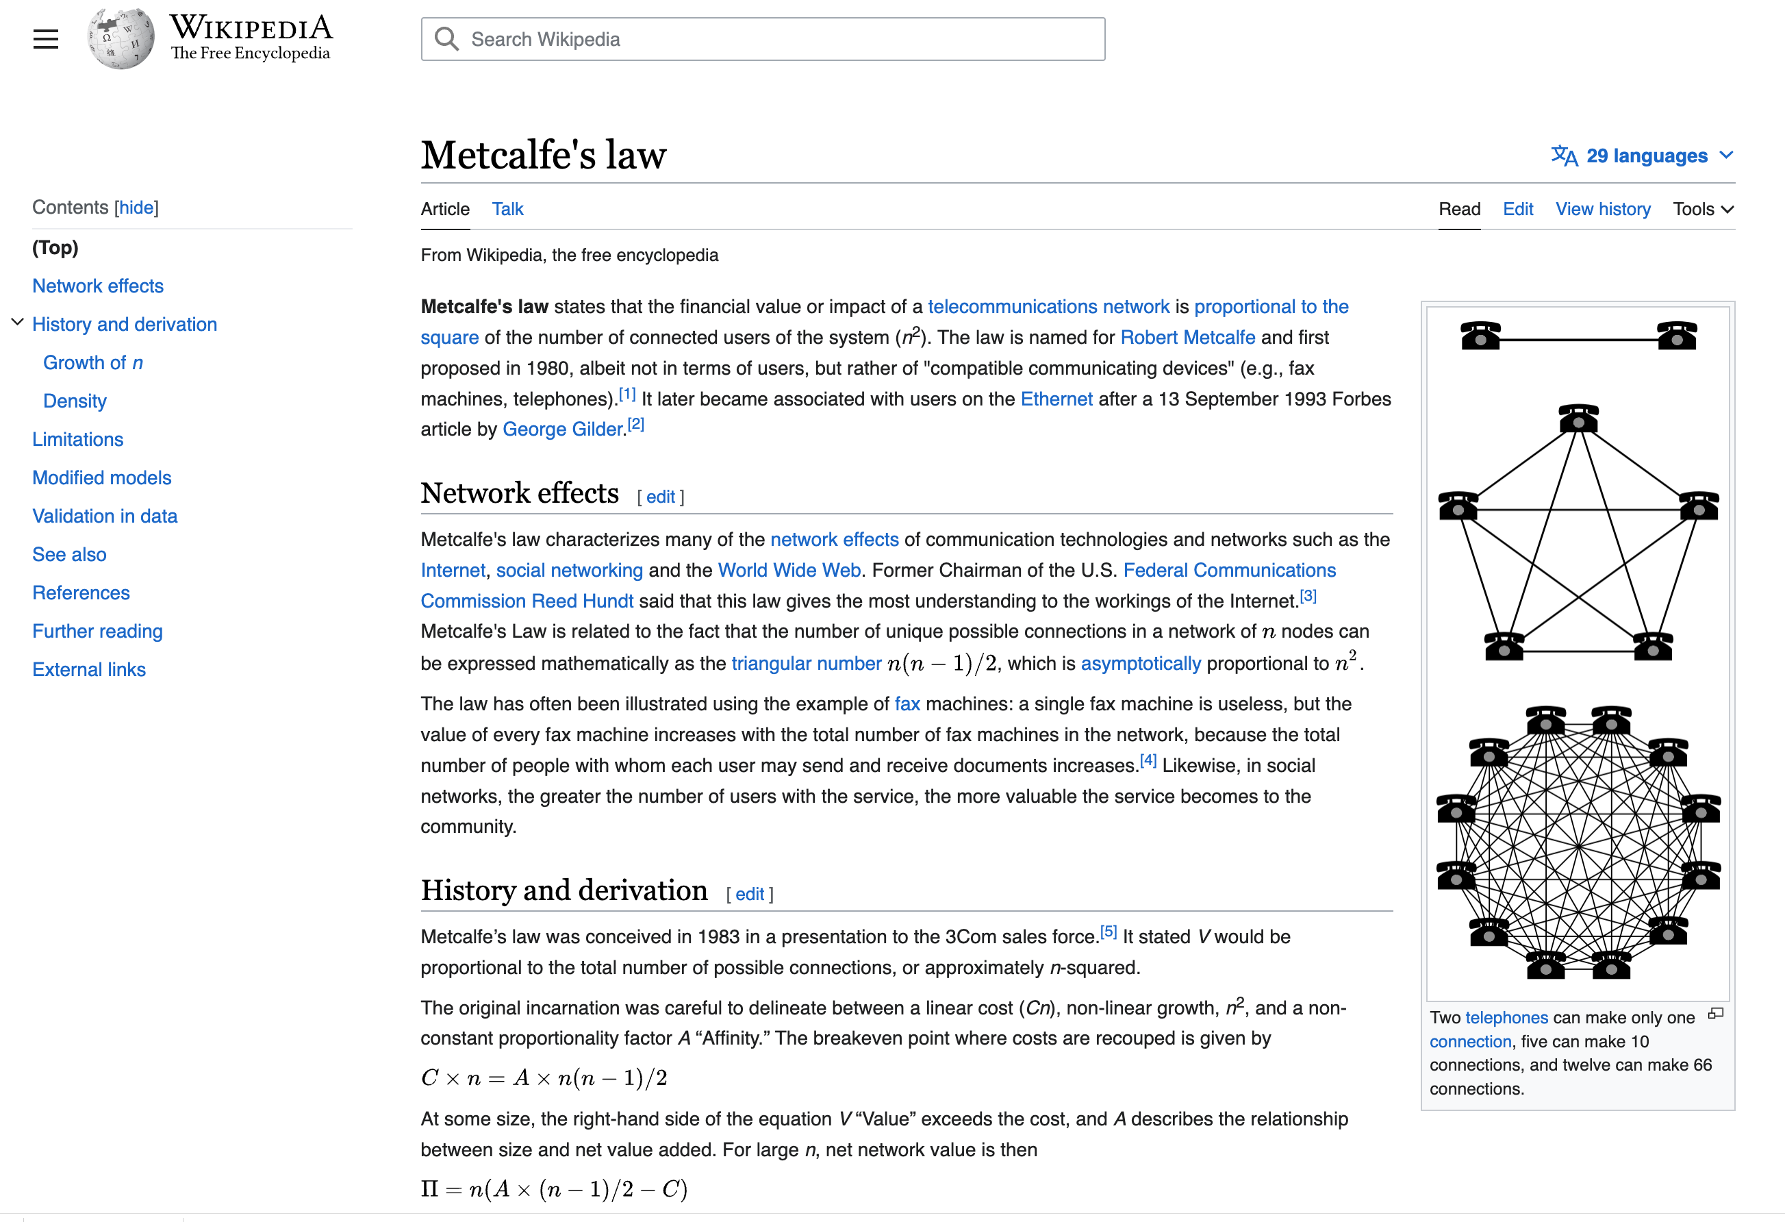

Slide 35
Deliverables
Better access to literature
Resources:
Many embeddings for many papers
More models to be posted on HuggingFace
Code to be posted on GitHub
Methods to compare and contrast across small (and large) collections of documents
Support incremental updates to embeddings based on citation graphs
Evaluation: Better numbers, as well as better benchmarks
Establish that combinations of text and links are better together (than either by itself)
Establish that citing sentences are useful
Improve methods for assigning papers to reviewers
Theory: Unified framework of deep nets and Linear Algebra

Slide 36
Summary of Discussion of Use Cases
Recommender Systems: what should I read? Cite?
Input: query (text and/or documents)
Output: documents
Opportunity: many systems focus too much on relevance
Don’t want papers that are buzz word compliant, but not credible
Most papers aren’t cited (and aren’t worth reading or citing)
Routing submissions to reviewers
Features: text, abstracts, links, etc.
Opportunity: many systems (openreview, softconf, CMT, etc.)
Few successes: iffy software is worse than what we used to do by hand
Bad for society
Summarization
Most summarization systems process each document, one by one
Can we compare and contrast a pair of documents?
What if we had a large collection of documents?
Cluster collection (with kmeans)
Compare within and across clusters

Slide 37
What’s Where (GitHub; Globus)

Slide 38
Outline
Data
Use Cases
What’s Where (GitHub; Globus)
Tutorial Background

Slide 39
Overview of Github
Useful Links:
Zoom Link, Meeting Notes, Slides, Notation, Deliverables, Reading List
Source Code, Access to Big Data Files (1TB), Examples, Documentation
Installation Instructions
Example Use Case: Get Embeddings
Some require access to Big Data Files, and
Some do not
Example Outputs: Rank Retrieval
Input: paper id
Output: paper ids

Slide 40
Example of Semantic Scholar Page https://www.semanticscholar.org/paper/On-the-Dangers-of-Stochastic-Parrots%3A-Can-Language-Bender-Gebru/6d9727f1f058614cada3fe296eeebd8ec4fc512a https://github.com/kwchurch/JSALT_Better_Together/blob/main/src/fetch_from_semantic_scholar_api.py https://www.semanticscholar.org/product/api
Ad hoc requests

Slide 41
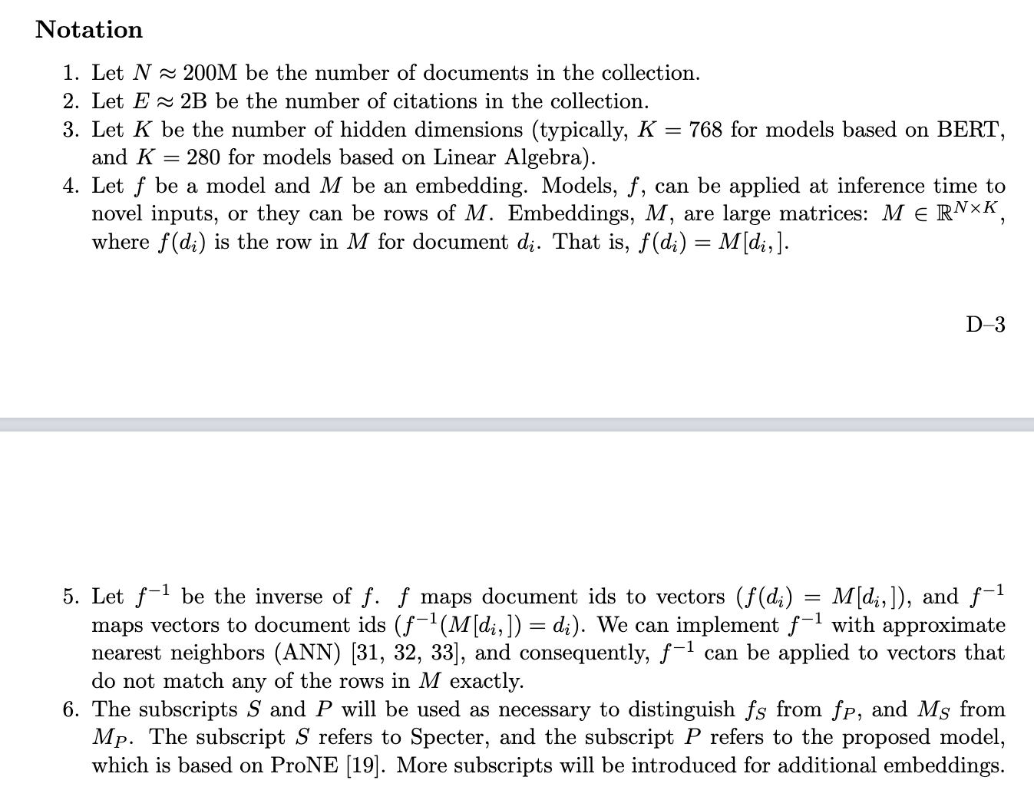
https://github.com/kwchurch/JSALT_Better_Together/blob/main/doc/Notation.md

Slide 42
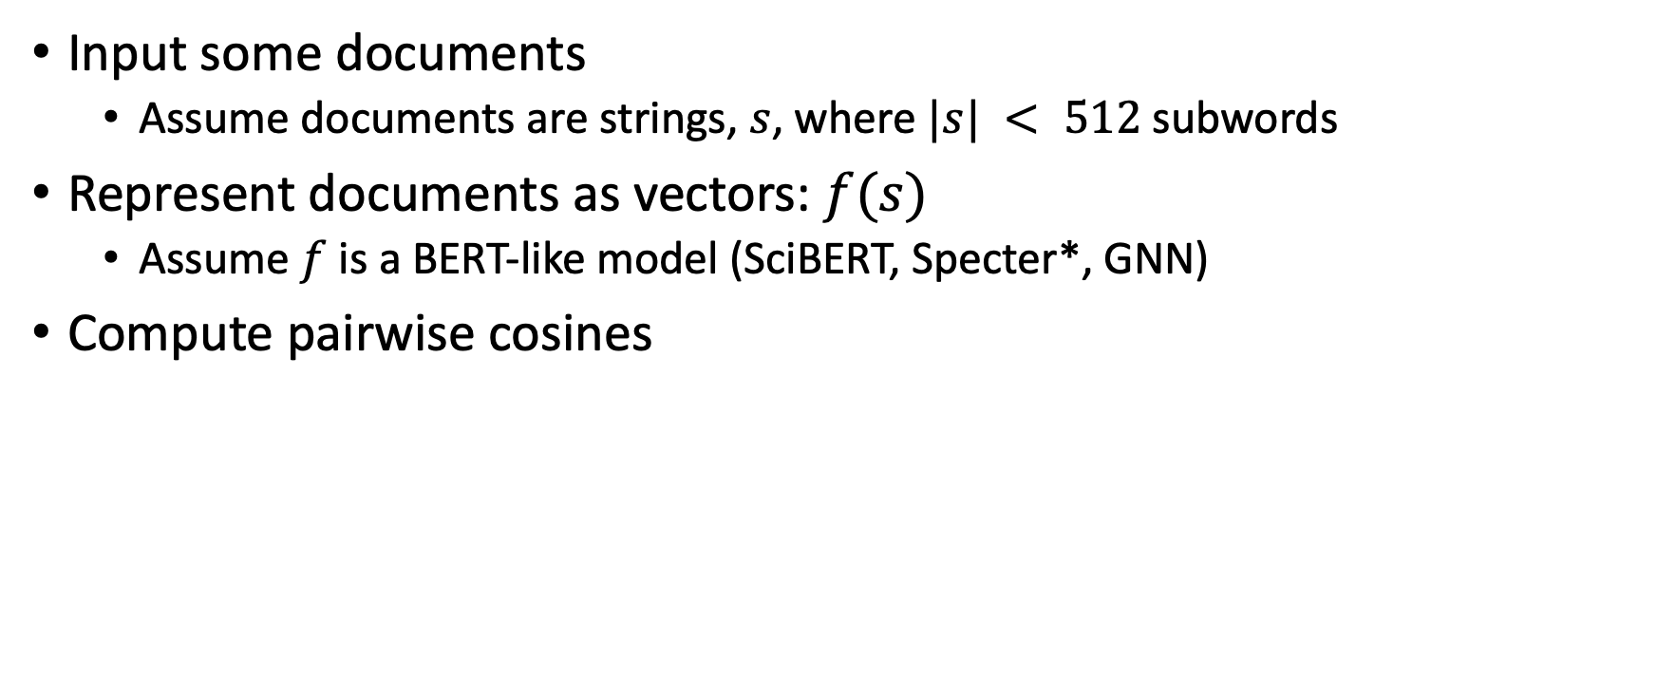
Inference Exercise: Document Similarity
Input some documents
Assume documents are strings, $s$, where $|s| < 512$subwords
Represent documents as vectors: $f(s)$
Assume $f$ is a BERT-like model (SciBERT, Specter*, GNN)
Compute pairwise cosines

Slide 43
Example Use Case: Get Embeddings Text, Paper Ids and/or Vectors → Vectors
Methods
Semantic Scholar API
HuggingFace model
Use (large) precomputed tables
Dependencies
Fewest dependencies
Semantic Scholar API
Modest network connectivity
Modest dependencies
HuggingFace model
More cycles
More python skills
Most dependencies
Use (large) precomputed tables
Considerable disk space & RAM
Need large tables (Globus)
C code from github

Slide 44
Example Use Case: Get Embeddings Text, Paper Ids and/or Vectors → Vectors
Methods
Semantic Scholar API
HuggingFace model
Use (large) precomputed tables
Functionality
Semantic Scholar API
Supports ad hoc queries
Input: paper ids (no text)
HuggingFace model
Input: text (no paper ids)
Use (large) precomputed tables
Input: paper ids or vectors
Output: paper ids or vectors
Supports ANN
(approx. nearest neighbors)
maps paper ids to vectors
and vice versa
Speed: startup & throughput

Slide 45
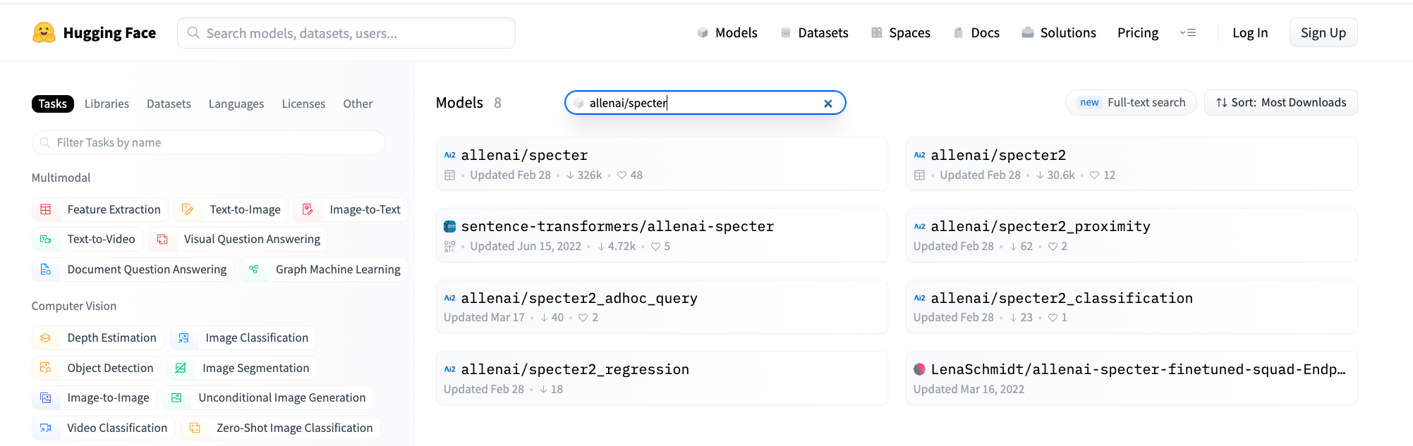
https://huggingface.co/models?sort=downloads&search=allenai%2Fspecter

Slide 46
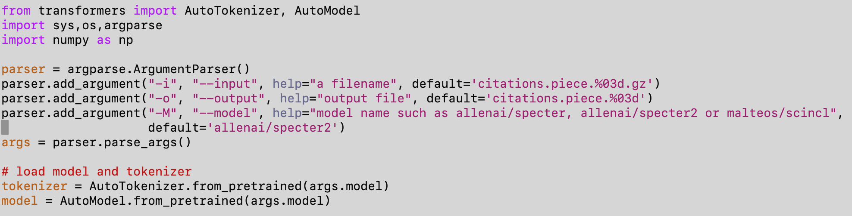
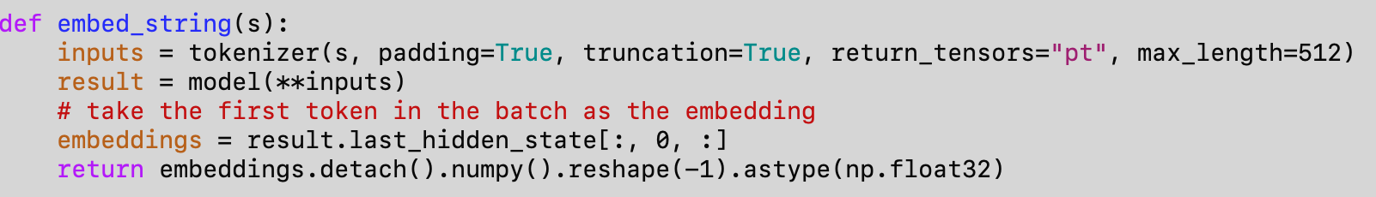

Inference: $f(s)$ → vector of 768 floats https://github.com/kwchurch/JSALT_Better_Together/blob/main/src/text_to_embedding.py

Slide 47
Overview of Github
Useful Links:
Zoom Link, Meeting Notes, Slides, Notation, Deliverables, Reading List
Source Code, Access to Big Data Files (1TB), Examples, Documentation
Installation Instructions
Example Use Case: Get Embeddings
Some require access to Big Data Files, and
Some do not
Example Outputs: Rank Retrieval
Input: paper id
Output: paper ids

Slide 48
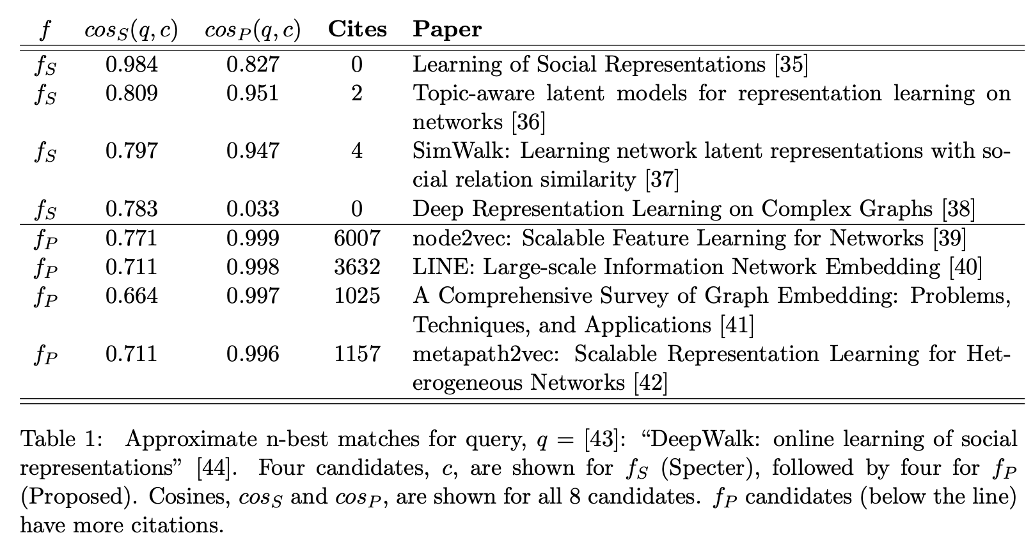
https://github.com/kwchurch/JSALT_Better_Together/blob/main/examples/similar_documents/reading_list/DeepWalk.md

Slide 49
Example Outputs: Rank Retrieval
Precomputed Outputs
For a few queries
No dependencies
https://github.com/kwchurch/JSALT_Better_Together/blob/main/examples/similar_documents/reading_list/DeepWalk.md
Instructions for computing your own (for many queries)
Requires large tables (and C code)
https://github.com/kwchurch/JSALT_Better_Together/blob/main/doc/find_similar_docs.md

Slide 50
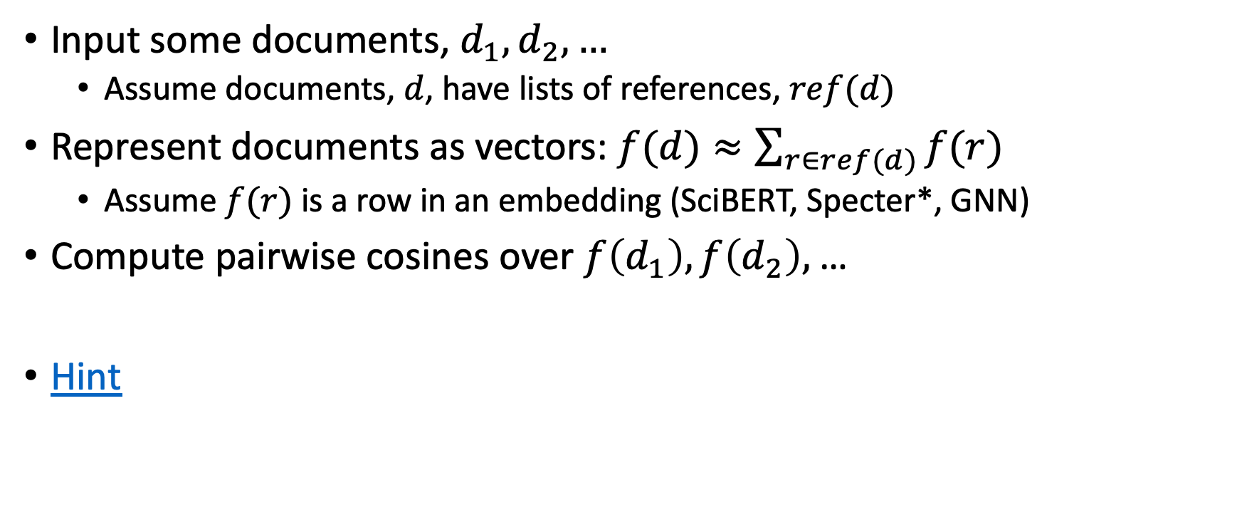
Inference Exercise 2: Document Similarity (but use references instead of titles)
Input some documents, $d_{1},d_{2},…$
Assume documents, $d$, have lists of references, $ref(d)$
Represent documents as vectors: $f(d)≈\sum_{r∈ref(d)}{f(r)}$
Assume$f(r)$ is a row in an embedding (SciBERT, Specter*, GNN)
Compute pairwise cosines over $f\left(d_{1}\right), f\left(d_{2}\right),$…
Hint

Slide 51
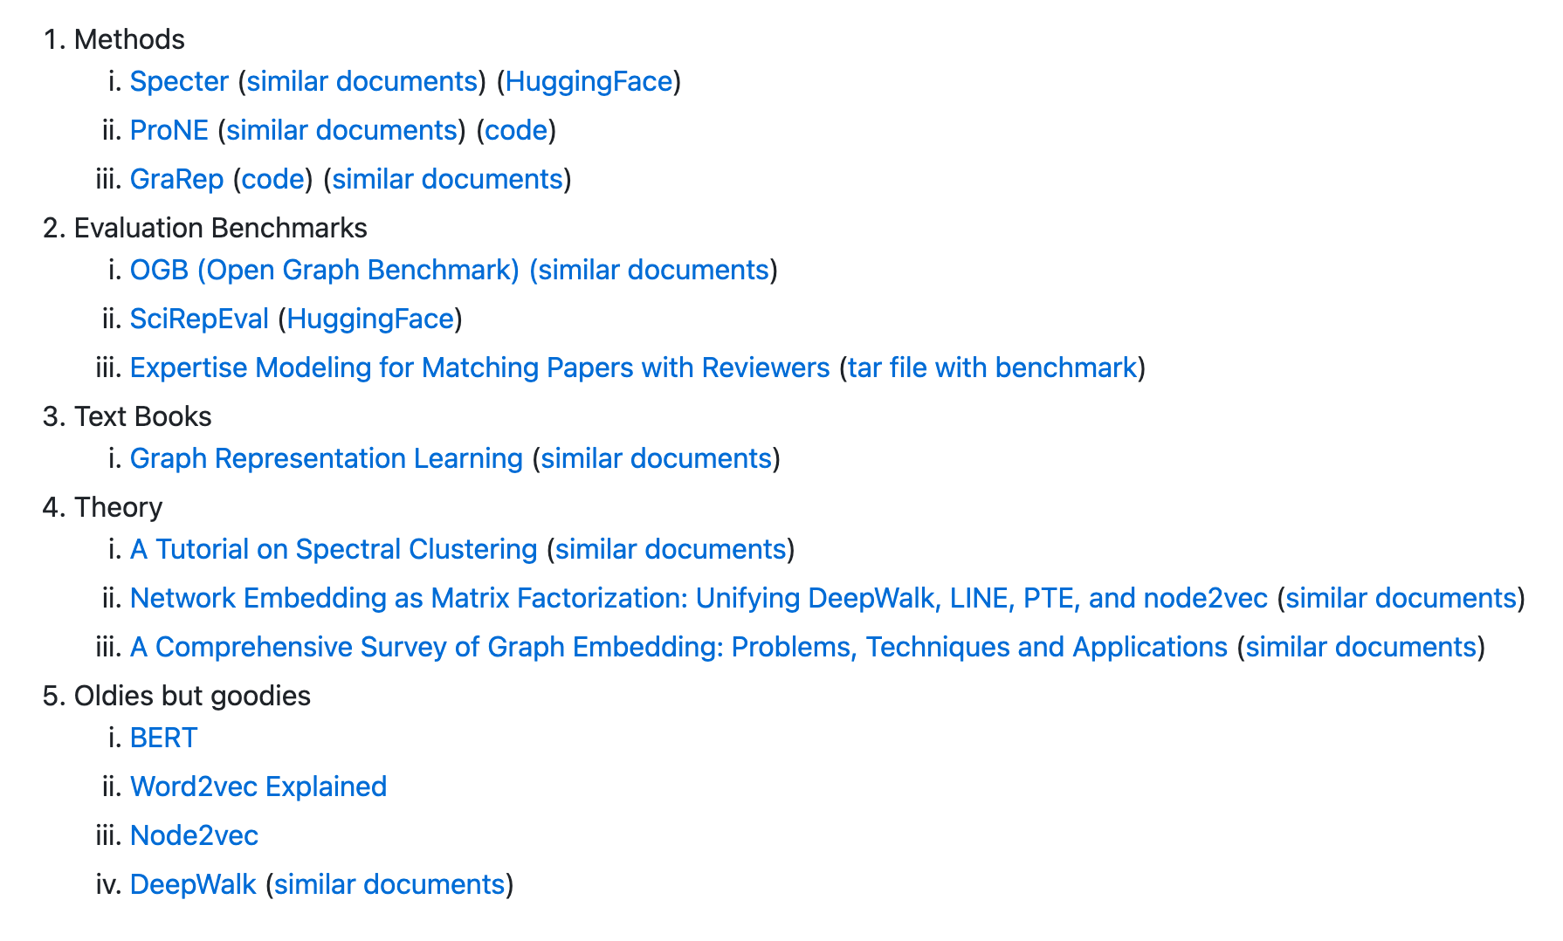
Reading List

Slide 52
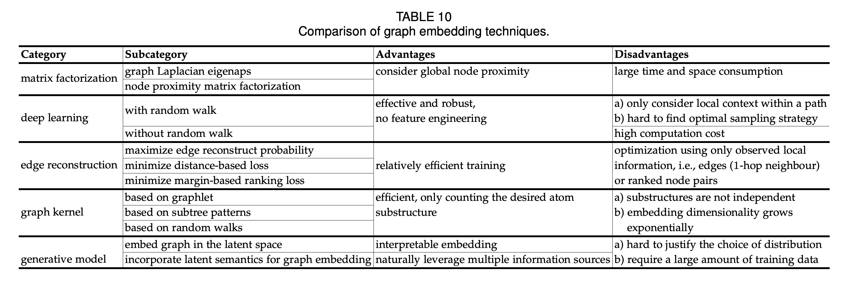
Linear Algebra & Deep Nets
A Comprehensive Survey of Graph Embedding: Problems, Techniques and Applications

Slide 53
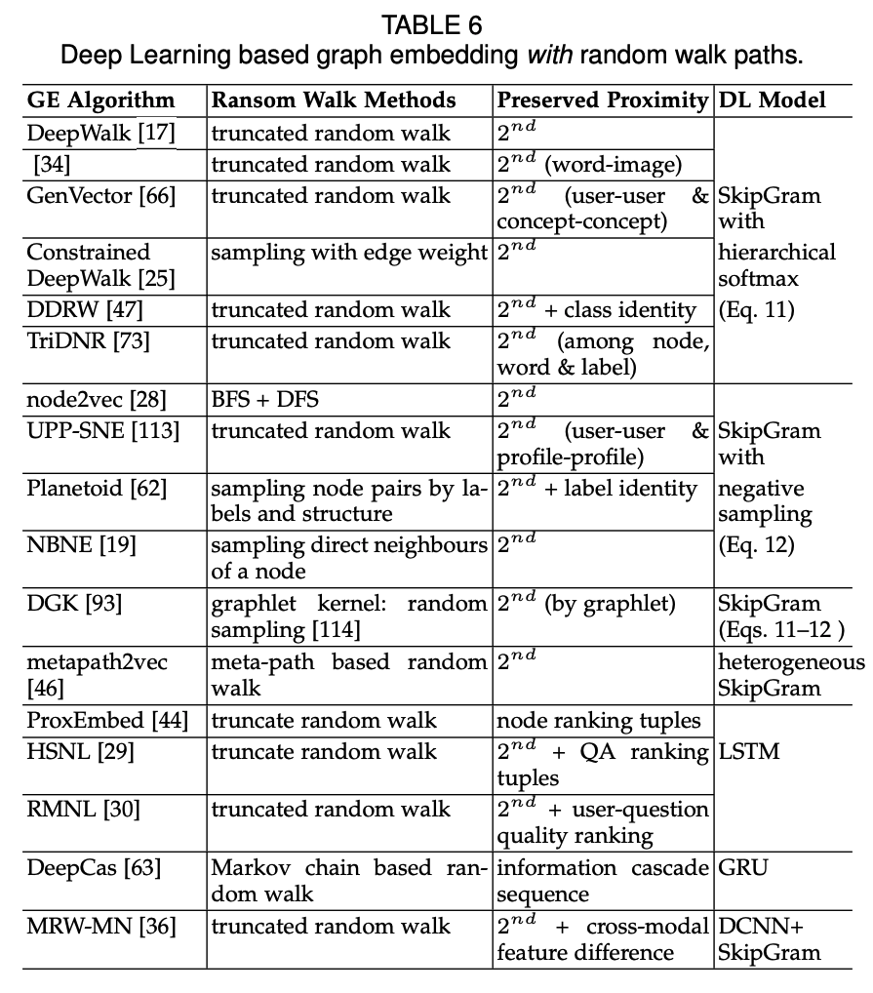
Different Matrix Factorizations →Proximity
A Comprehensive Survey of Graph Embedding: Problems, Techniques and Applications

Slide 54
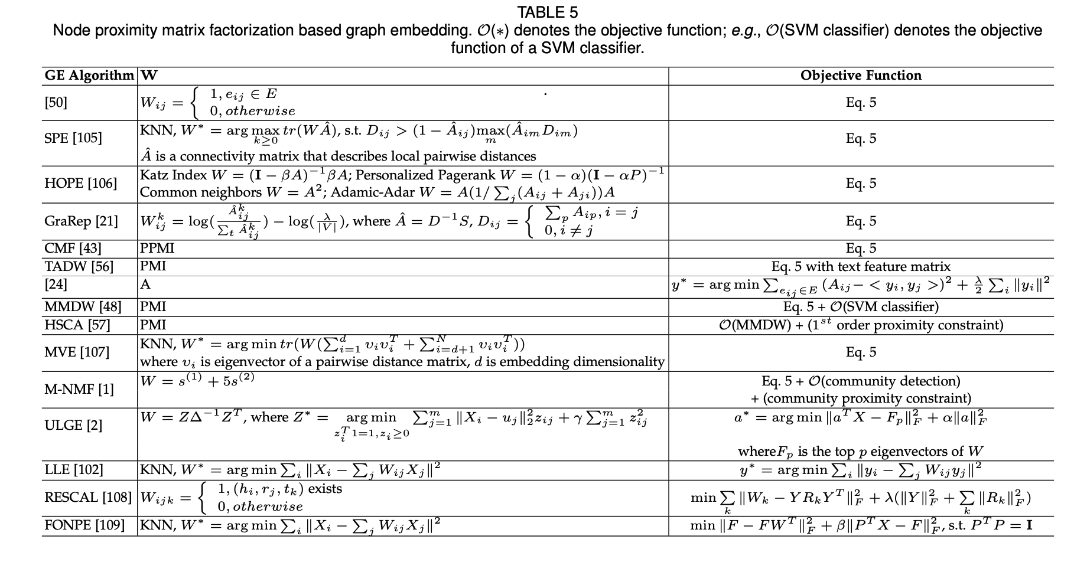
A Comprehensive Survey of Graph Embedding: Problems, Techniques and Applications

Slide 55
Summary: Overview of Github
Useful Links:
Zoom Link, Meeting Notes, Slides, Notation, Deliverables, Reading List
Source Code, Access to Big Data Files (1TB), Examples, Documentation
Installation Instructions
Example Use Case: Get Embeddings
Some require access to Big Data Files, and
Some do not
Example Outputs: Rank Retrieval
Input: paper id
Output: paper ids

Slide 56
backup

Slide 57
Agenda: Tutorial on Basic Background
GNNs: Fine-Tune BERT-like models with Graphs (Citations)
Challenge: Use citations at inference time
Semantic Scholar API
GitHub: https://github.com/kwchurch/JSALT_Better_Together
Deep Nets: Standard 3-step Recipe
Plug for ACL-2022 Tutorial (GFT = General Fine-Tuning)
Approximate Nearest Neighbors
Linear Algebra
Node2vec/ProNE

Slide 58
Sources for Papers in Semantic Scholar
 | Source | Papers (millions)
1 | CorpusId | 207.80
2 | MAG (Microsoft Academic Graph) | 182.18
3 | DOI | 113.54
4 | PubMed | 35.03
5 | DBLP | 6.06
6 | PubMedCentral | 4.86
7 | ArXiv | 2.15
8 | ACL | 0.08

Slide 59
Teaser: Goals for Recommender System
Recommender Systems
Relevance (on topic)
Importance (highly cited)
Do not return papers that are
Buzz word compliant
But not credible
(most papers are not cited)
Paper routing for conferences
Submissions → reviewers
Conjectures:
Iffy software
Automatic assignments are worse than manual assignments
Reviewers are less qualified and less sympathetic to background
than target audience
Better assignments → better conferences

